Slide 1
Minimally Invasive Monocusp Valve
By: Tyler Adam Martinez, Mason Forshage, and Adrian Rodriguez

Slide 2
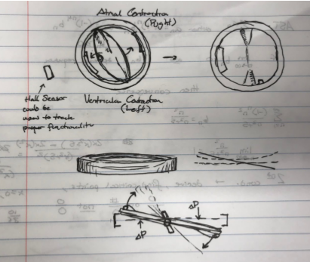
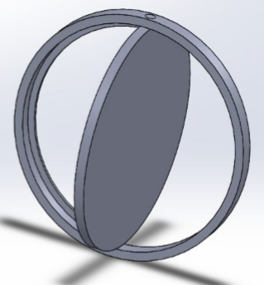
The Initial Valve

Slide 3
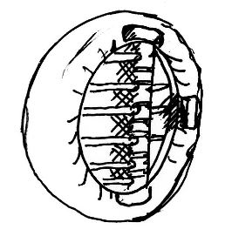
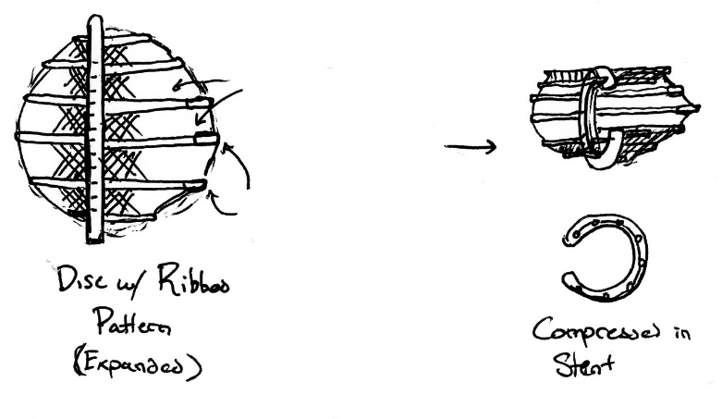
Current Design

Slide 4
Materials
Outer Ring: Kevlar Fabric/ Nitinol Stent
Inner Ring: Pure Pyrolytic Carbon
Spine: Pure Pyrolytic Carbon over Titanium Wire
Disc: Pure Pyrolytic Carbon Ribs with Kevlar Fabric Membrane*

Slide 5
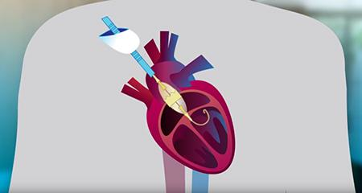
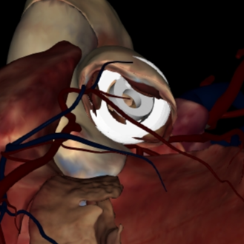
Implantation
Transcatheter Aortic Valve Replacement
Minimally Invasive
FDA approved for “low risk patients”

Slide 6
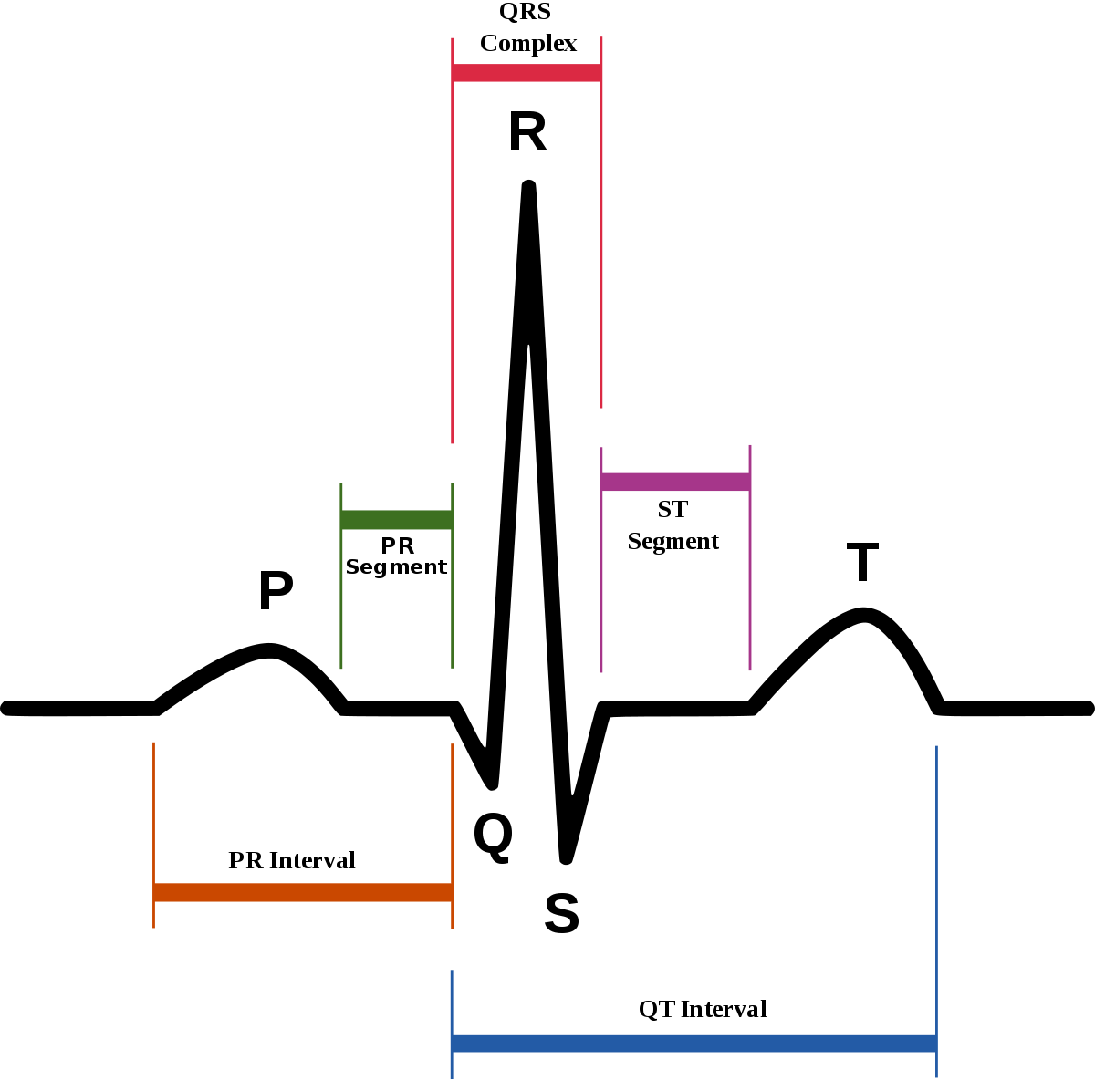
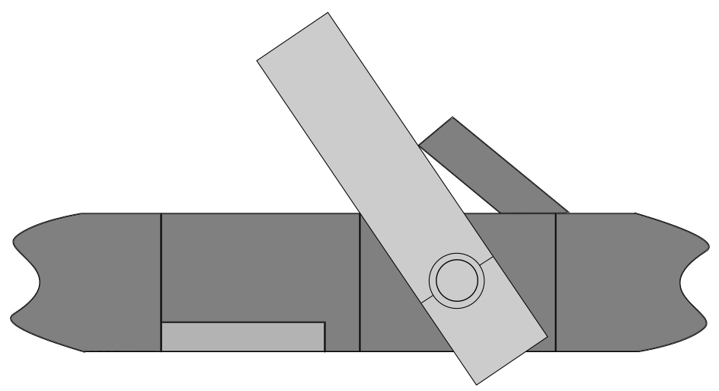
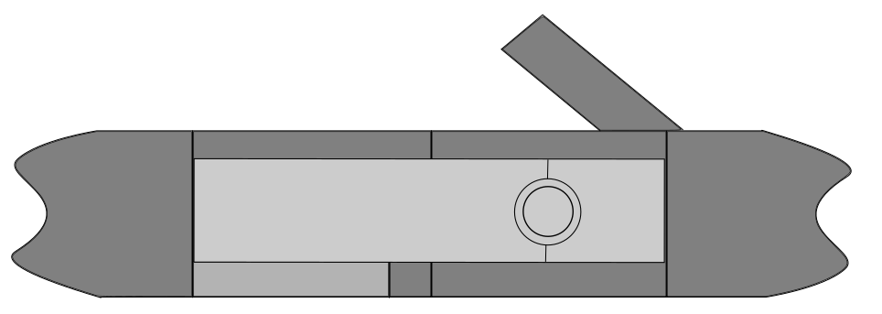
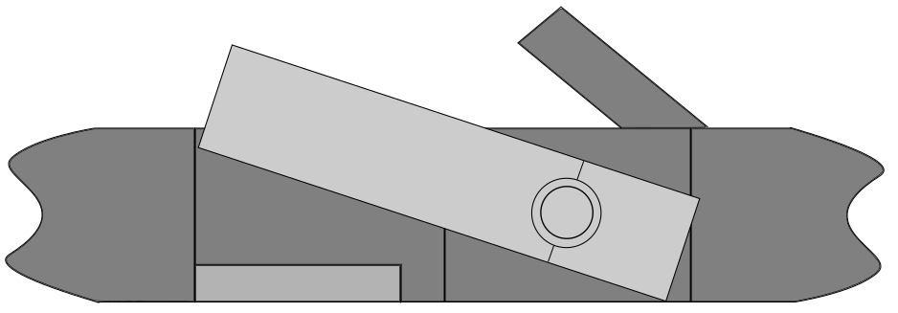
Mechanics of the Valve and the
Forces affecting the Valve
Left ventricle is relaxed:
(P Phase)
Left ventricle contracts:
(QRS Phase)
Left ventricle begins to relax:
(T Phase)
L
Pressure/Backflow
Pressure/Backflow
θ
θ
θ
L
Pressure/Blood flow
W
W
W

Slide 7
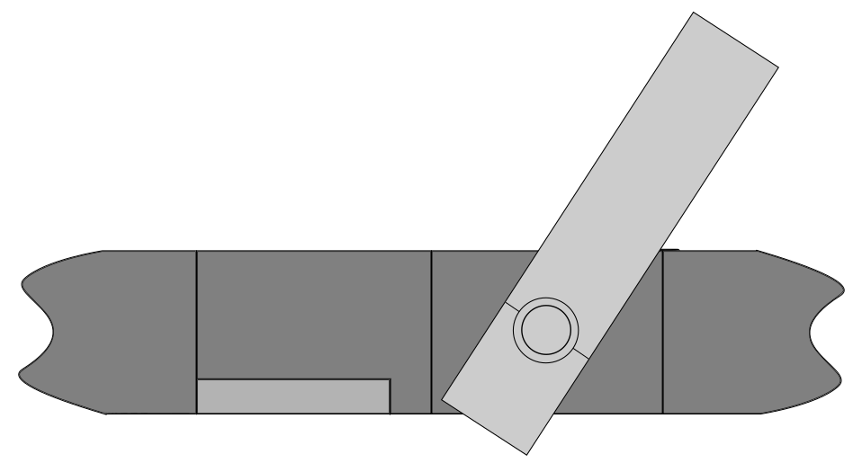
Without the upper lip...
Reverse flow/Pressure

Slide 8
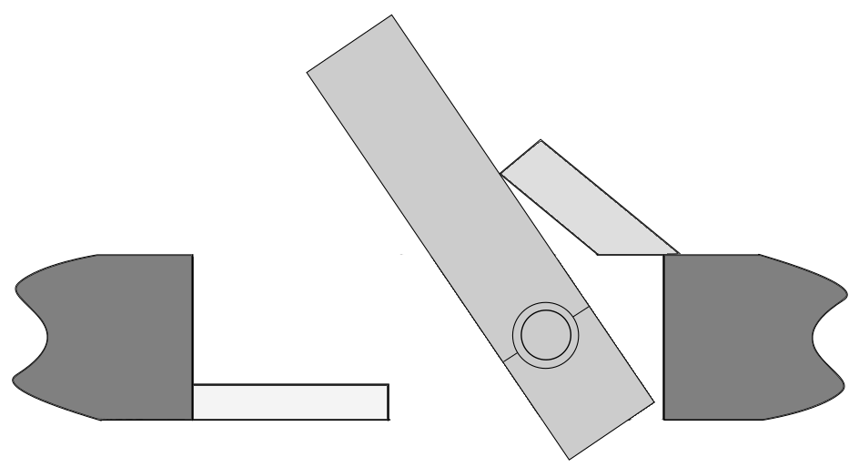
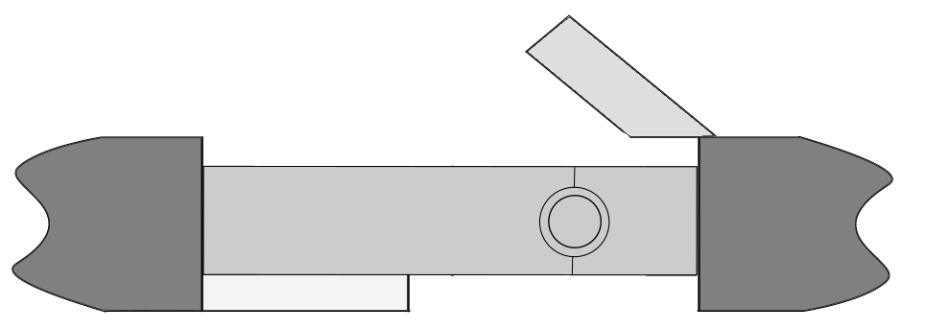
Fluid Mechanics of the Valve
Weak blood flow
Leakage flow
Reverse flow
Strong blood flow

Slide 9
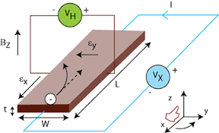
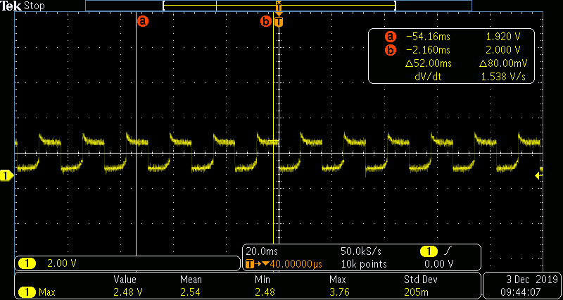
Hall Effect and Sensor
Notes:
The image of right is a screenshot from a digital oscilloscope of the simulated[1] signal from the hall sensor used for proof of concept.
[1] The simulated signal was produced by attaching a magnet to a servo motor and programming the motor to actuate the magnet the exact way that the magnet would move inside the valve, and placing the sensor in front of the valve, like where the sensor would go.

Slide 10
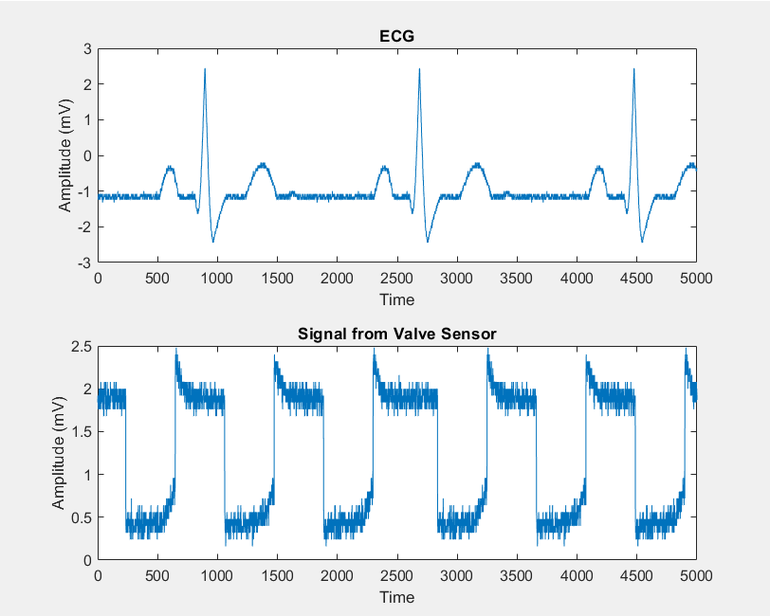
The MATlab simulation

Slide 11

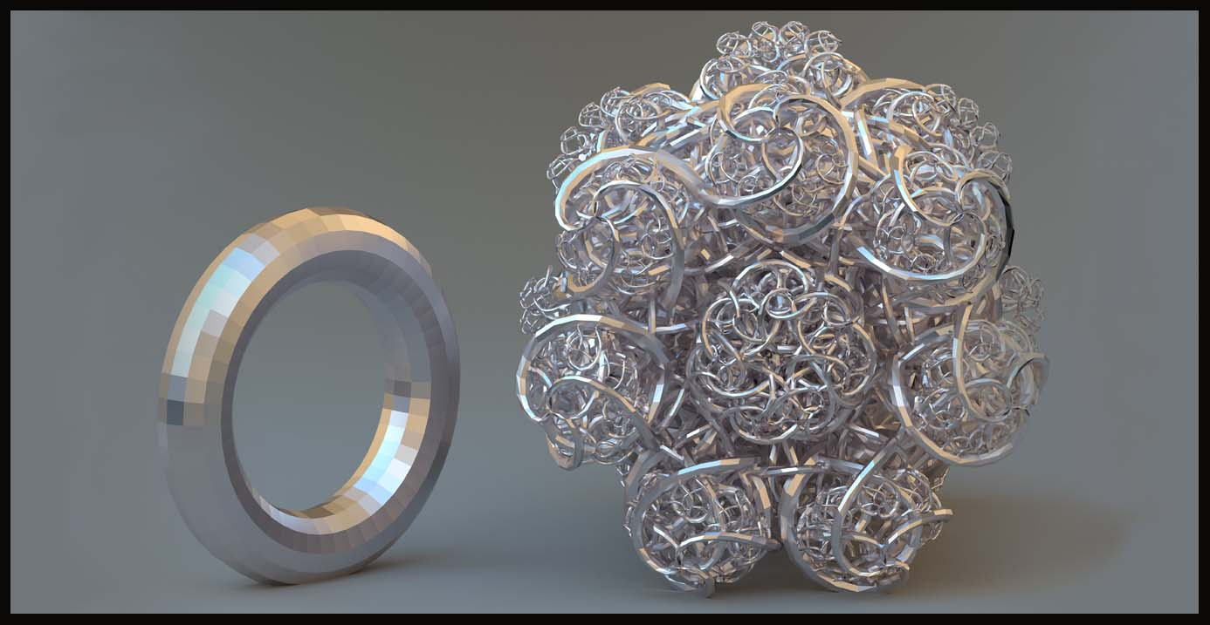
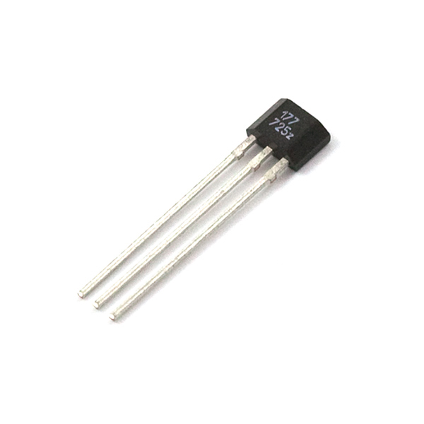
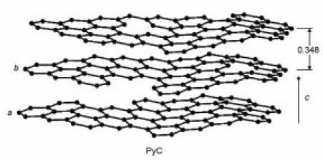
Design Justification
Notes:
Sensor provides real time feedback to the patient and the patient’s doctor.
The simplicity of the design. Means it’s less likely to fail.
The sensor we used to measure the hall effect:
https://www.sparkfun.com/products/9312
The material we are using is resistant to erision:
https://www.sciencedirect.com/science/article/pii/B9781845692452500263

Slide 12

Design Limitations
Monocusp Design may Hinder Laminar Flow
Included Magnet may Disrupt Pacemakers
Unforeseen Flaws without Testing

Slide 13


Github & Questions?
Notes:
Github:
https://github.com/TylerFonzie8507/Minimally-Invasive-Monocusp-Valve
References:
[1] https://www.mayoclinic.org/diseases-conditions/aortic-valve-disease/symptoms-causes/syc-20355117
[2] https://www.heart-valve-surgery.com/heart-surgery-blog/2008/03/24/pig-heart-valve-how-long-do-they-last/
[3] https://cardiothoracicsurgery.biomedcentral.com/articles/10.1186/s13019-019-0956-1
[4] https://www.ncbi.nlm.nih.gov/pmc/articles/PMC4810599/
[5] https://www.ncbi.nlm.nih.gov/pmc/articles/PMC4881630/
[6] http://www.molbio.upol.cz/stranky/vyuka/OSE2/2011/Mixa.pdf
[7] https://www.acc.org/latest-in-cardiology/articles/2019/08/16/13/49/fda-expands-tavr-indication-to-low-risk-patients
[8] https://www.ncbi.nlm.nih.gov/pmc/articles/PMC1768554/
[9] https://www.researchgate.net/profile/Robert_More/publication/292306650_Pyrolytic_Carbon/links/5ce399aa92851c4eabb174c0/Pyrolytic-Carbon.pdf
[10] https://patentimages.storage.googleapis.com/8d/c4/b7/7ac6ef0bd7ea0e/US9603698.pdf
[11] https://www.ncbi.nlm.nih.gov/pmc/articles/PMC2752693/

